Slide 1

Predicting top Songs within Spotify’s Categories
Colin Fitzgibbons

Slide 2
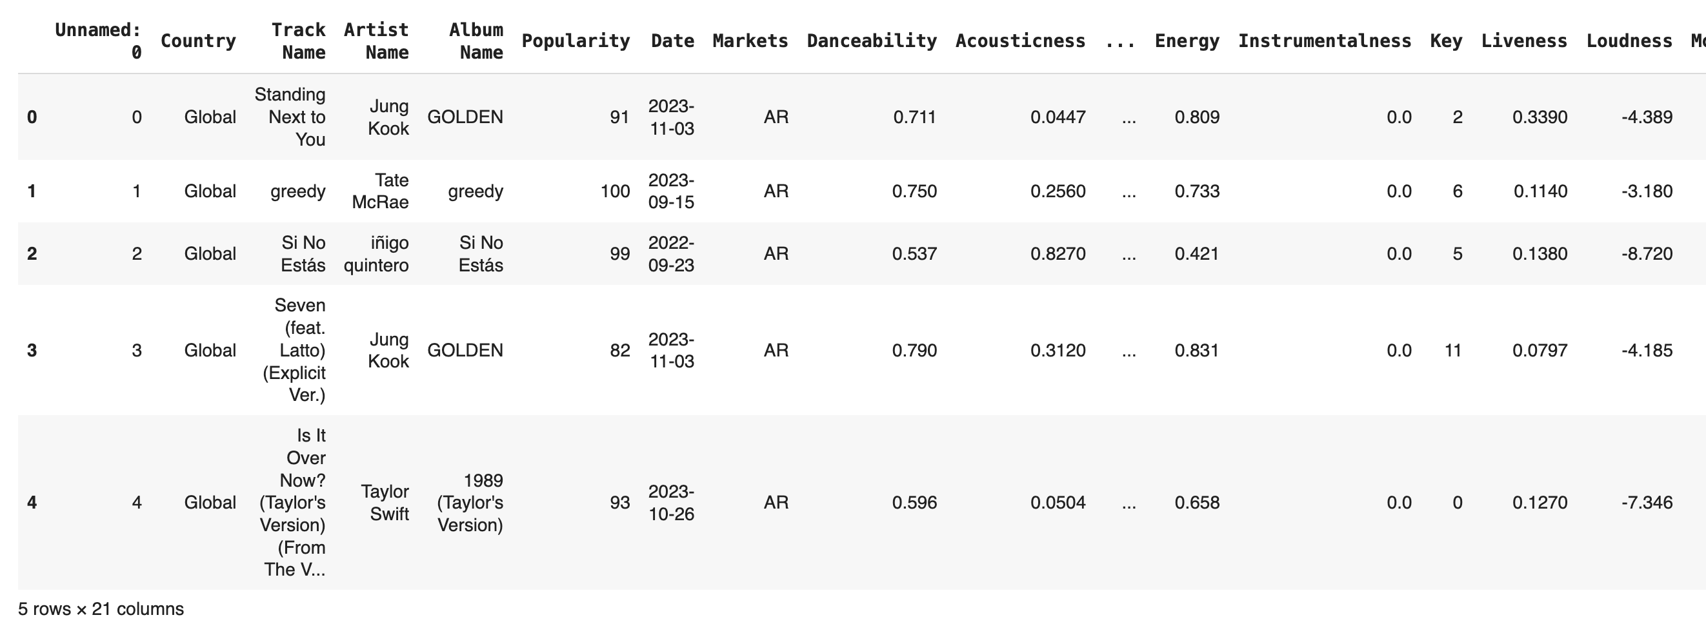
Spotify’s Categories
Including the songs on the top 50 for a country or worldwide, Spotify has ten categories that songs are scored into based on their elements.
These categories include Danceability, Acousticness, Liveness, Energy, Instrumentalness, Loudness, Speechiness, Tempo, and Positiveness.
Looking for factors that share common traits with top songs

Slide 3
Datasets Used and Preprocessing
With all datasets from Kaggle, I used:
A dataset reflecting the top 50 musicality songs globally and ranked by country
A dataset reflecting some of the most unpopular songs on Spotify
A dataset with the top 100 songs from Spotify between the years of 2010-2019
Data was cleaned by dropping null values and duplicate columns
Aiming to build predictive model using three datasets to determine what categories play into popularity compared to unpopularity
Predicting categories such as Danceability and Positiveness will factor in

Slide 4
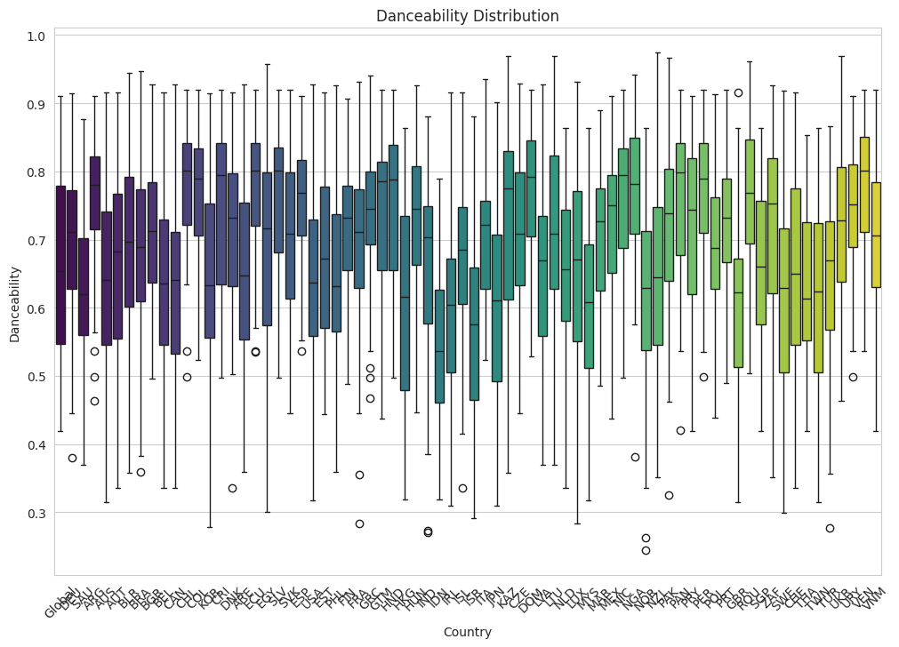
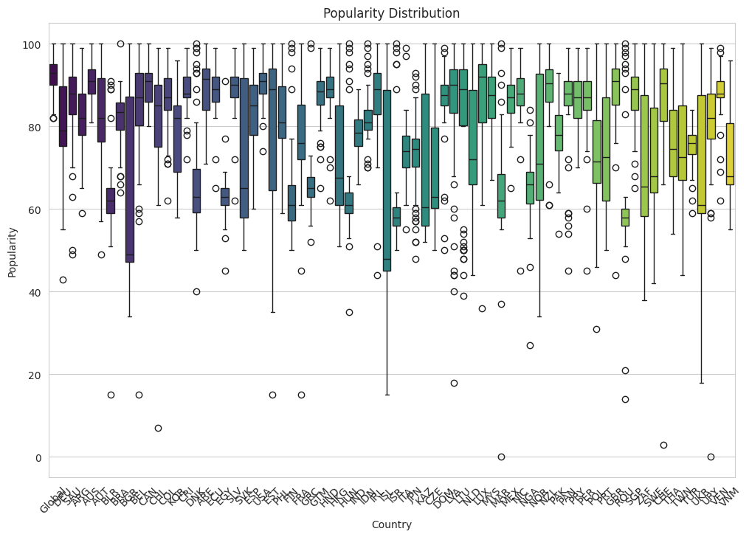
Data Visualizations of Distribution for top 50

Slide 5
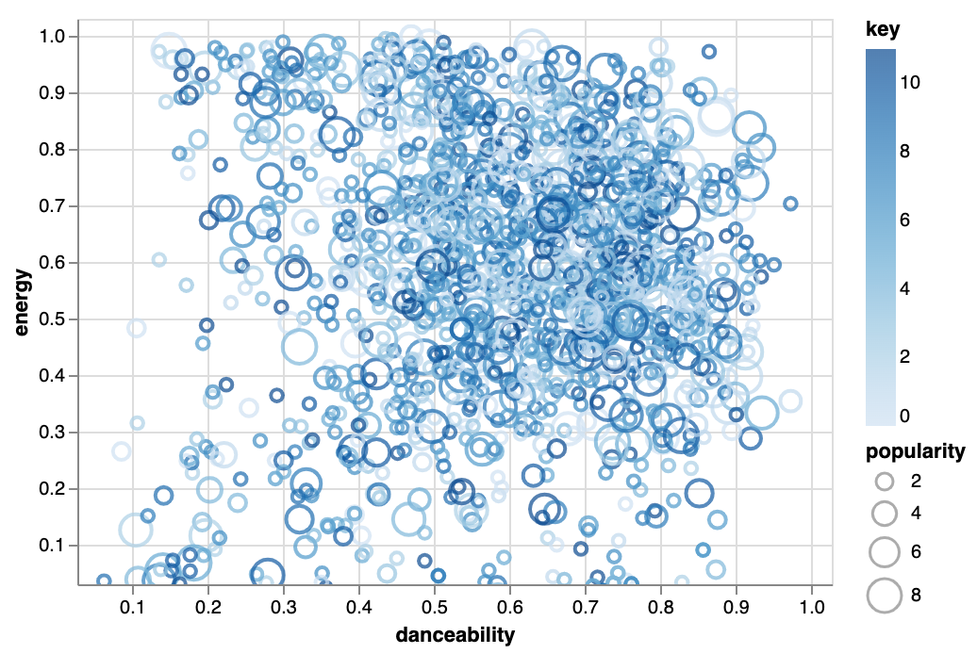
Data Visualization for Unpopular Songs

Slide 6
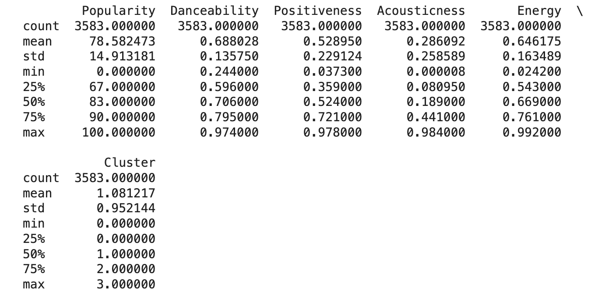
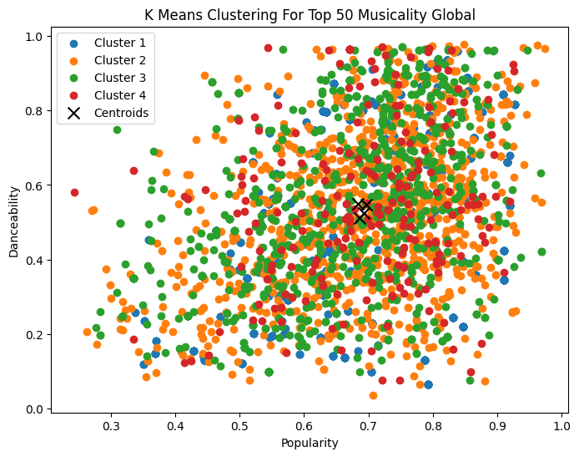
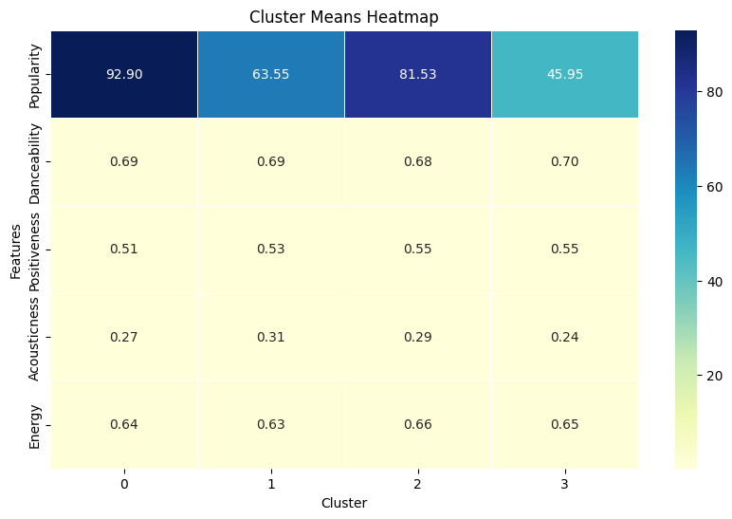
K-Means Clustering and Visualization (Top 50)
Popularity vs. Danceability
Heatmap with 4 Categories

Slide 7
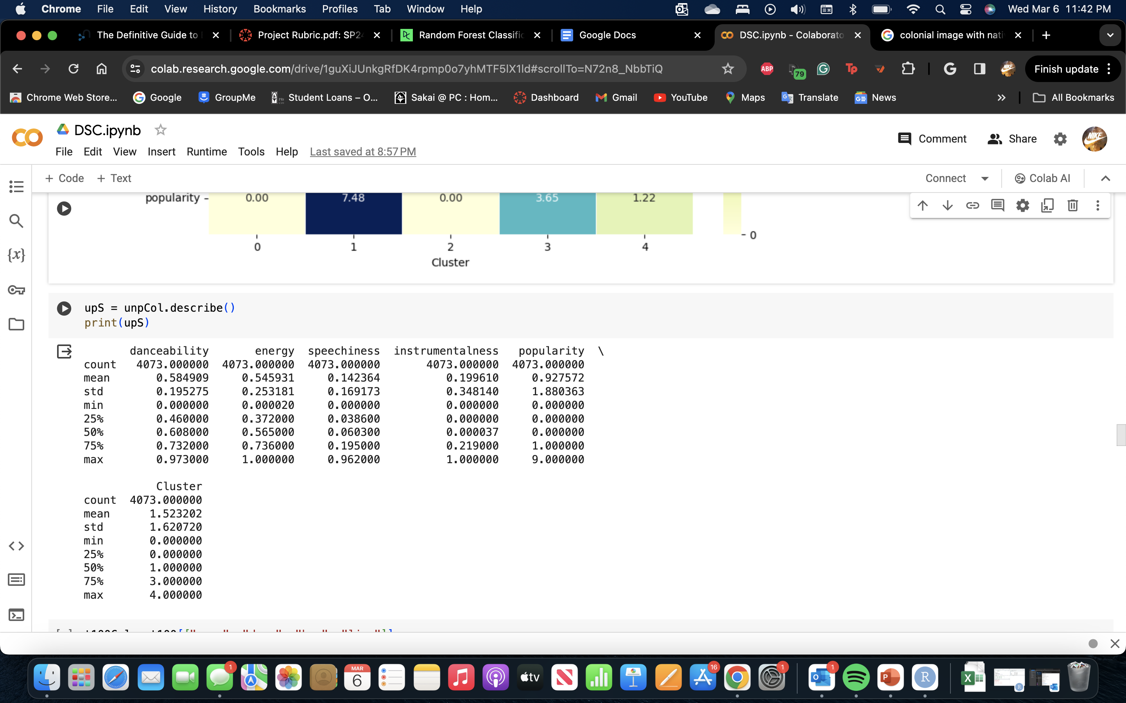
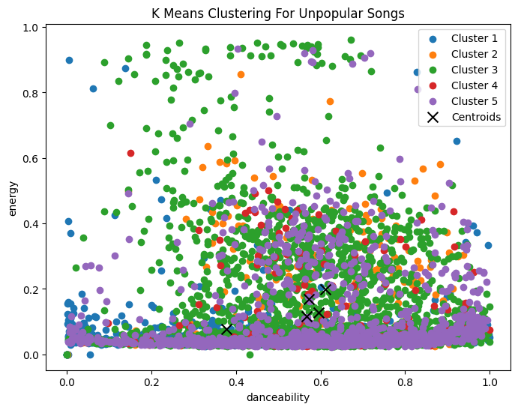
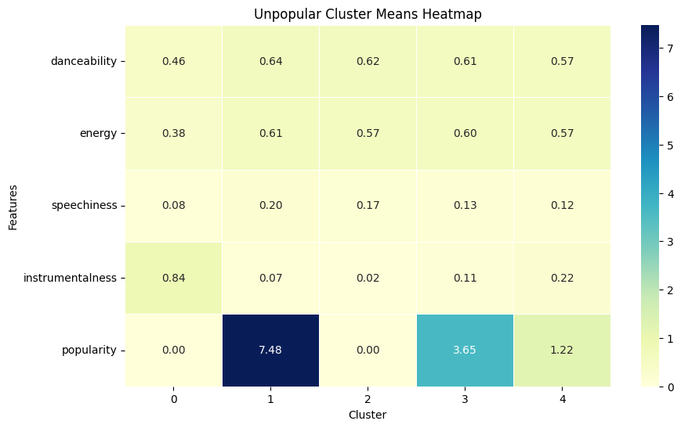
K-Means Clustering and Visualization (Unpopular)
Energy vs. Danceability
Heatmap with 4 Categories

Slide 8
Predictive Modeling Challenges
Datasets were unable to be stacked due to varying structure and columns within datasets holding multiple different names
Three separate models for datasets
Attempting to build with a larger dataset required more computing power
MSE were higher than normal for models chosen, however, showed to be the lowest out of all models experimented with
Data is only ranked within Spotify’s Categories and not within outside influence and marketing
Out of Random Forest Regression, a Neural Network, KNN regression model, and Decision Tree models, Linear Regression showed to hold a lower MSE.

Slide 9
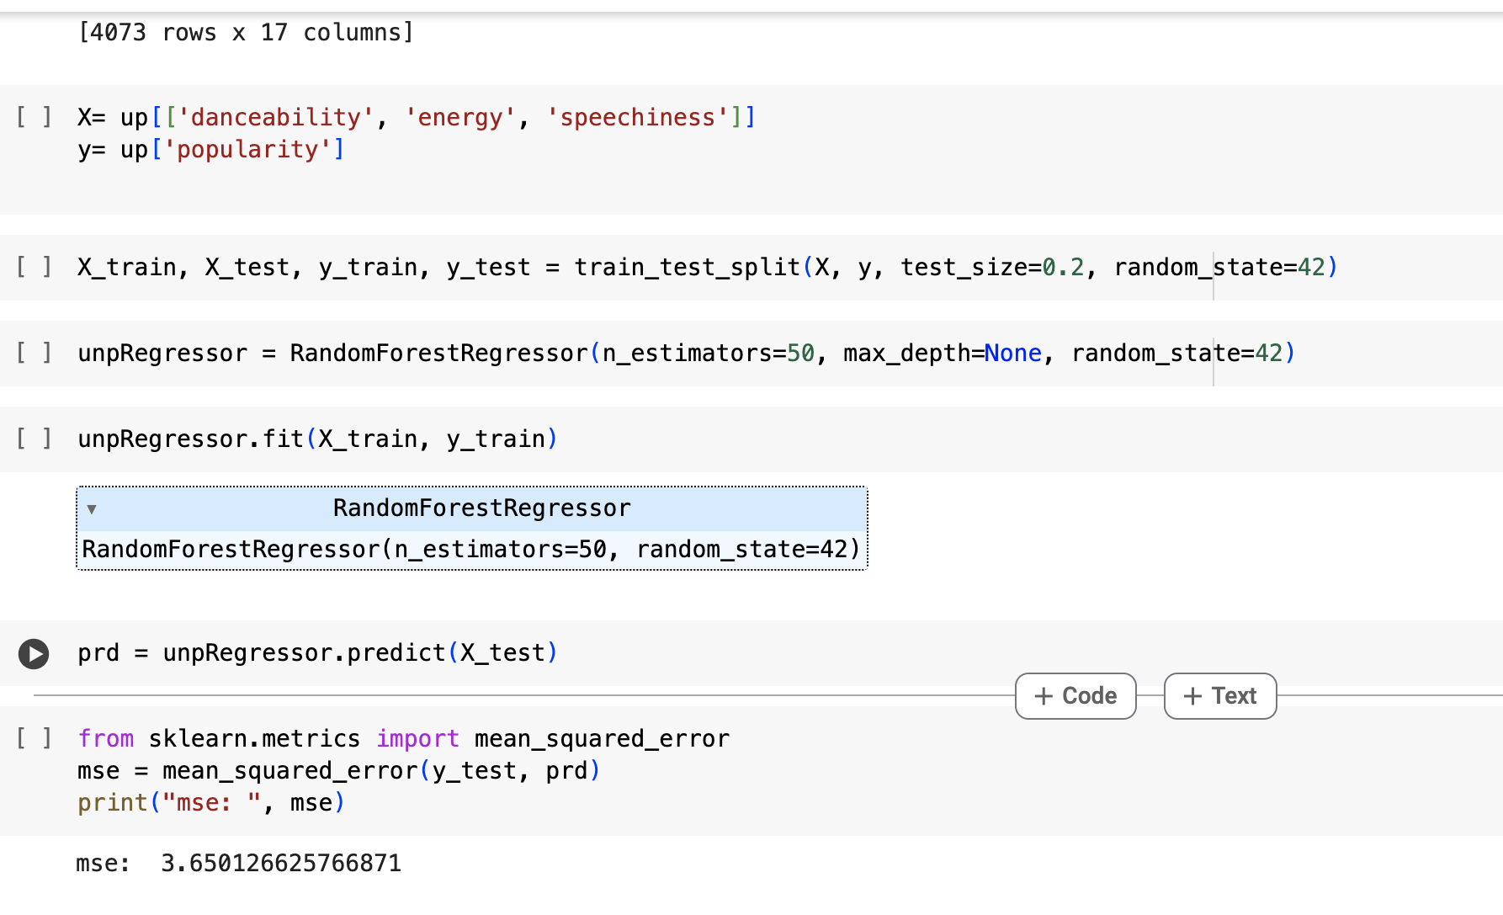
Linear Regression Models
Out of the three models created, the linear regression model for the dataset of Unpopular songs proved to hold the highest accuracy and lowest MSE.
Trained with a size of 0.2, a random state of 42, and 50 estimators.
Predicted using categories of Danceability, Energy, Speechiness, Acousticness, Positiveness, liveness, valence, and BPM.

Slide 10

Concluding Factors
While the Linear Regression model did not hold a low MSE for all datasets, the Unpopular dataset proved to be the most significant within all three that were used.
The categories of Danceability and Positiveness contributed to a song’s popularity or lack of popularity, but categories such as speechiness, instrumentalness, and energy also contributed as per the Unpopular dataset.

